Slide 1
UGBA 141 Production and Operations Management
Emerging IV E-Commerce
Professor Park Sinchaisri
Notes:
Guest Speaker 30
25 Amazon case
15 on Supply Chain
10 on Online marketplaces
20 Platform Operations: 10 minutes on network effects + 10 minutes on two-side

Slide 2
Course Announcement
2 weeks from now: 75-hour Littlefield Simulation
Monday 1pm – Thursday 4pm (No classes on Mon/Wed)
You can use our classroom to work with your team!
Tuesday: Google case report due
Wednesday: Future of Work + Intro to Littlefield Simulation
Sunday: One-page Brief Project Report due (1 point)
Sign up for Boba/Coffee Casual Chats ☺
You can now choose to submit either HW4 or HW5

Slide 3

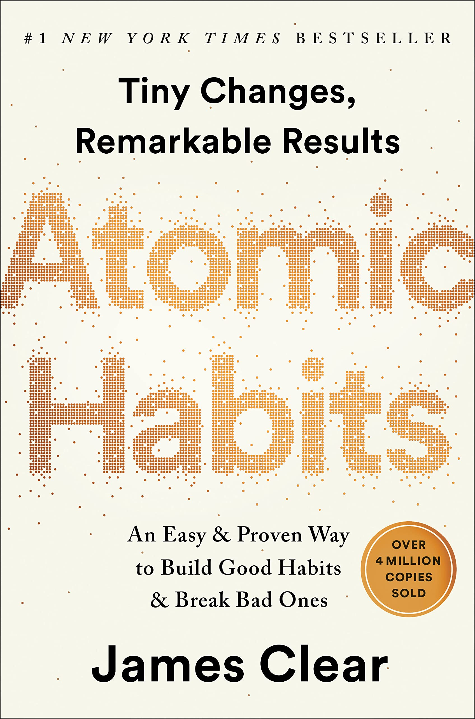


Products with G < L
(selling price not much larger than unit production cost; rapid obsolescence so salvage value of unsold units is low)
Products with G > L
(selling price much larger than unit production cost)
Area to left of
profit-maximizing
stocking level =
critical ratio
Profit-maximizing
stocking level
units demanded
Notes:
Critical ratio less than 50%
STOCK LESS THAN EXPECTED DEMAND (Undershoot)
Critical ratio more than 50%
STOCK MORE THAN EXPECTED DEMAND (Overshoot)

Slide 4
Slow/Fast Movers
Slow-moving item
A slow-moving item (“slow mover”) is a product that has relatively low demand over a given time period, such as a month or week. That is, the item sells at a slow rate.
Such items tend to have relatively high uncertainty in demand: the standard deviation of demand is large relative to the mean.
Example: obscure books, mature electronics, home appliances
Fast-moving item
A fast-moving item (“fast mover”) is a product that has relatively high demand over a given time period, such as a month or week. That is, the item sells at a fast rate.
Such items tend to have relatively low uncertainty in demand: the standard deviation of demand is small relative to the mean.
Example: best-selling book, new tech products, gas, milk

Slide 5


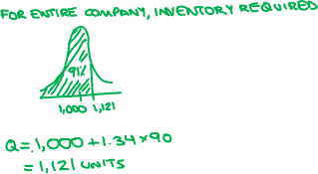
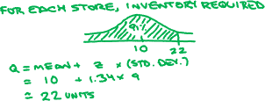
Stocking Slow Movers
Forecast demand per store = normally distributed with mean 10 and standard deviation 9. Want 91% service level (z=1.34).
Brick-and-mortar retailer
Bookstore chain with 100 stores
E-Commerce retailer
Serving demand out of single warehouse
Slow movers uneconomical to stock in physical stores (too much inventory required)
Slow movers only economical for e-commerce centralized inventory model
Notes:
E-Commerce model of centralized inventory (risk pooling) enables economical operations for slow-moving items, but with slow delivery.

Slide 6
Amazon Retailer or Logistics
Is Amazon a retailer or a logistics company company?
Global Shipping by Amazon
3rd party sellers
Logistics services (FBA)
Extensive infrastructure & competency
Online Retailer
Logistics
Own products
First/Middle/Last Mile
Notes:
3rd party sellers ←- logistics services
Technology online retailer. ←- logistics company exstensive infrastructure and competency

Slide 7
Amazon vs Traditional
Advantages
No limits on shelf space
Wide assortments/product variety
Economical to sell slow movers
Lower costs (real estate/labor)
Know more about customers
Disadvantages
Shipping/delivery delays
3rd party = no quality control
More customer support needed

Slide 8
Amazon Sales Velocity
Assortments in Amazon’s early days (when Amazon was exclusively a bookseller)
Amazon assortment
Amazon offered more than one million titles.
Amazon had small number of distribution centers.
Rationale: High inventory (and shelf space) costs make it uneconomical to stock “slow moving” items in physical stores. In ecommerce, centralizing inventory enables pooling efficiencies (and lower warehouse space costs), making stocking “slow moving” items economical.
Tradeoff to customers:
Amazon’s strength: wide product variety
Amazon’s weakness: shipping delay
Brick-and-mortar retailer assortment
Large brick-and-mortar bookstore stocked roughly 50,000 titles.
Barnes and Noble (B&N) had hundreds of stores (e.g., 793 in 2007).
Rationale: For fast moving goods, demand uncertainty is smaller and distributed inventory (e.g., in physical stores near customers) is economical, allowing customer to receive the product without delay.
Tradeoff to customers:
B&N’s strength: no shipping delay
B&N’s weakness: limited product variety
Notes:
Sales velocity shapes whether item is economical for brick and mortar vs. ecommerce retailer

Slide 9
Amazon Decisions
Sell 3rd Party Goods?
Pros:
Wide assortments/options
Network effects
Leverage/monetize SC logistics
Lower cost for 3rd party sellers
Cons:
Lose some control on quality
Lose sales to other people
Move into Physical Retail?
Pros:
Richer customer experiences
Closer to customers, touchpoints
Synergies with logistics operations
Stock based on local demand (e.g., Amazon 4-star stores)
Cons:
Saturated market
Expensive real estate/labor cost
Move away from core competency

Slide 10




Amazon Fast Delivery
Economical with centralized inventory, but at cost of delay to customers
Uneconomical to stock in physical stores close to customers
How have amazon’s growth & changed assortment support economical fast delivery?
SLOW MOVERS
ASSORT- LOCATION OF
MENT INVENTORY .
PAST
NOW
FAST MOVERS
Economical to stock close to customers in physical stores
Notes:
Write on the board
Sales growth -> Slow movers becomes fast mover -> Economical to carry close to customers -> Fast delivery -> Pricing Power

Slide 11
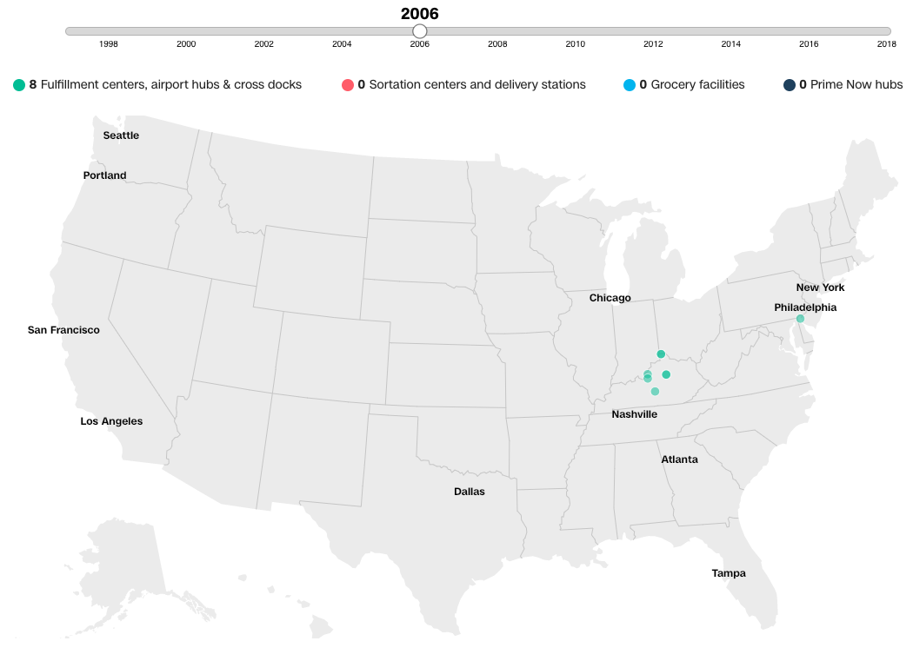
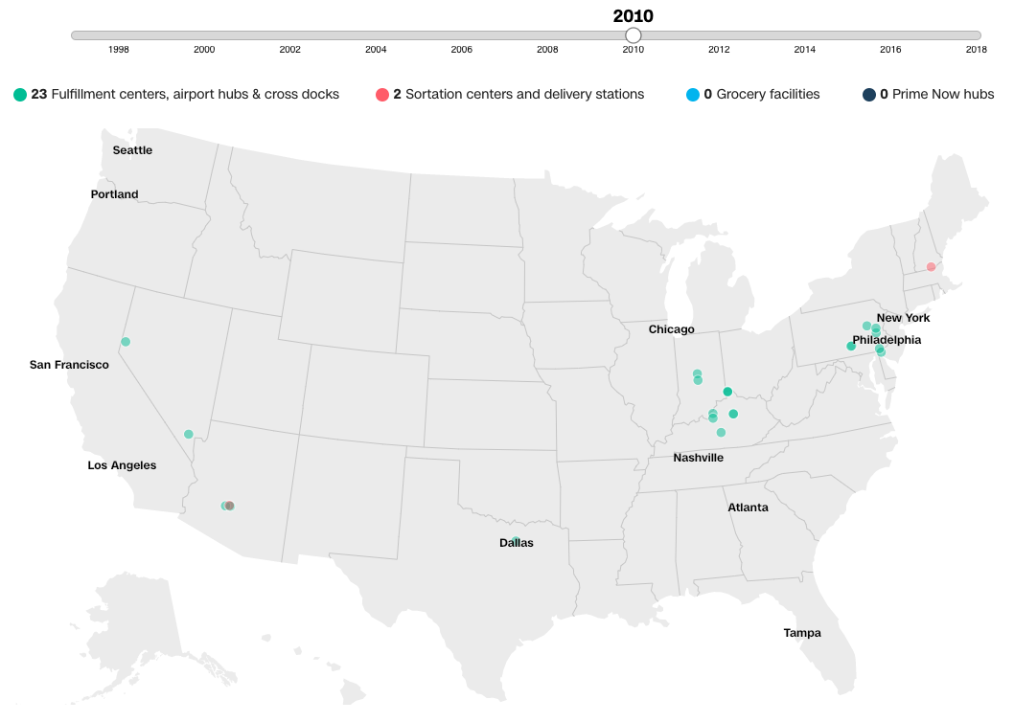
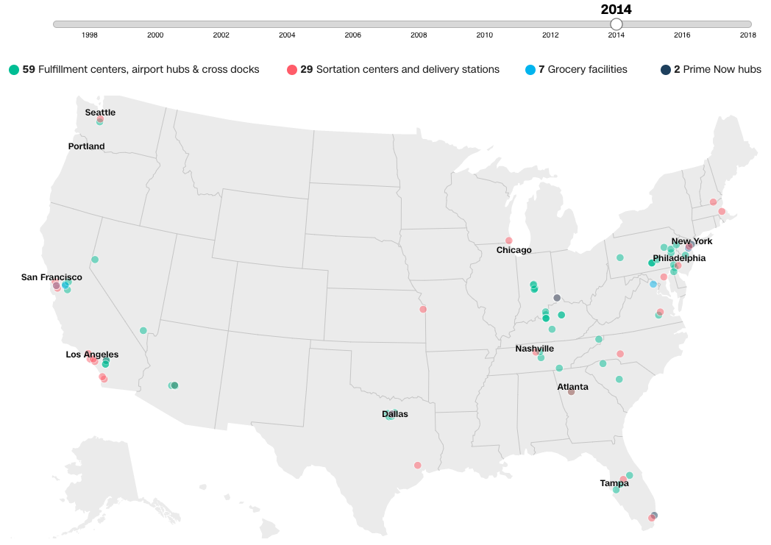
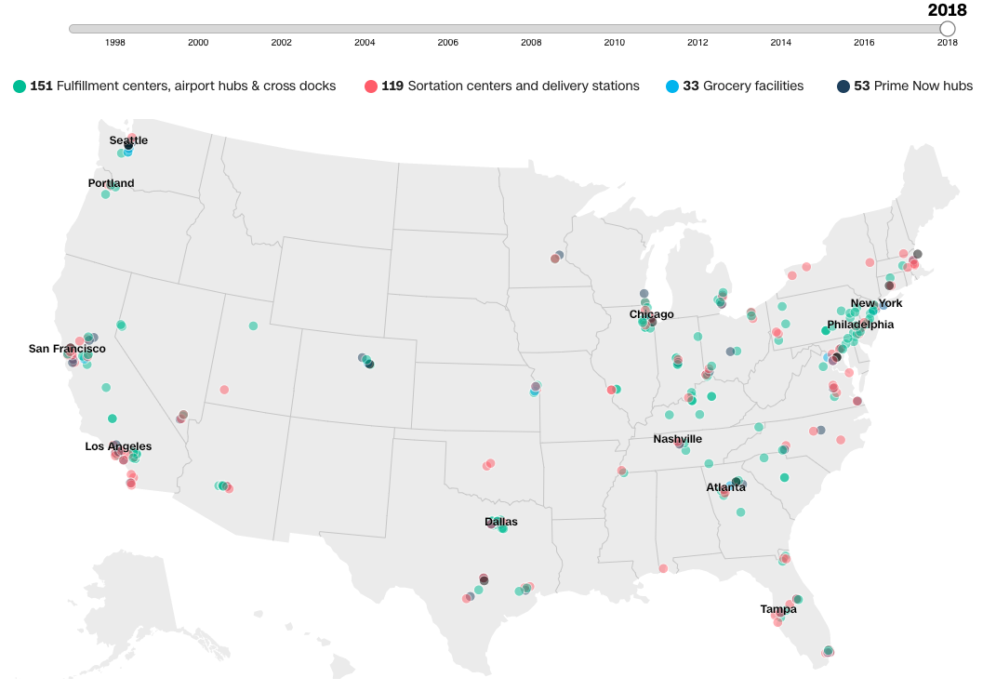
SOUTHWEST AIRLINES
Amazon facilities in the United States over time
Source: https://www.cnn.com/interactive/2018/10/business/amazon-distribution-map/index.html
Carrying inventory closer to final customers can help shipping/delivery speed (giving pricing power), sacrificing variety.
Notes:
“sacrificing variety”: amazon can offer great speed not for all items, bur rather primarily fast moving items. E.g. 4 star

Slide 12
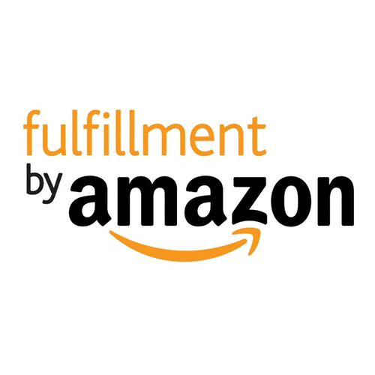
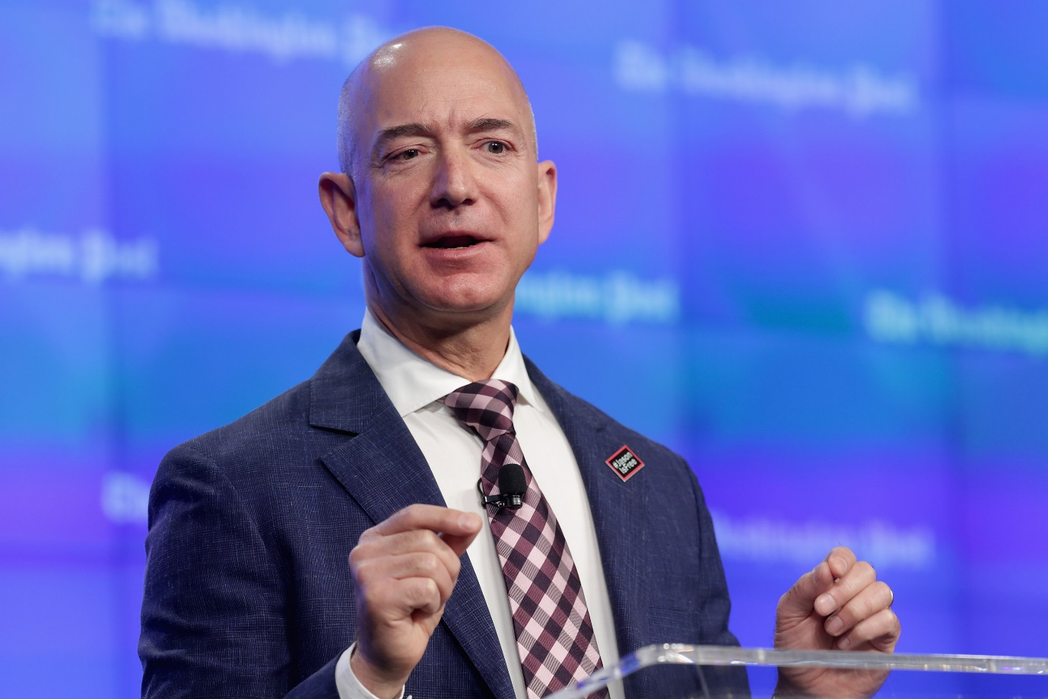
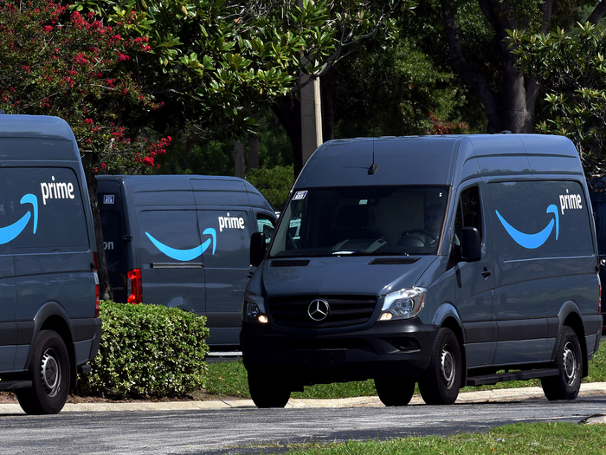
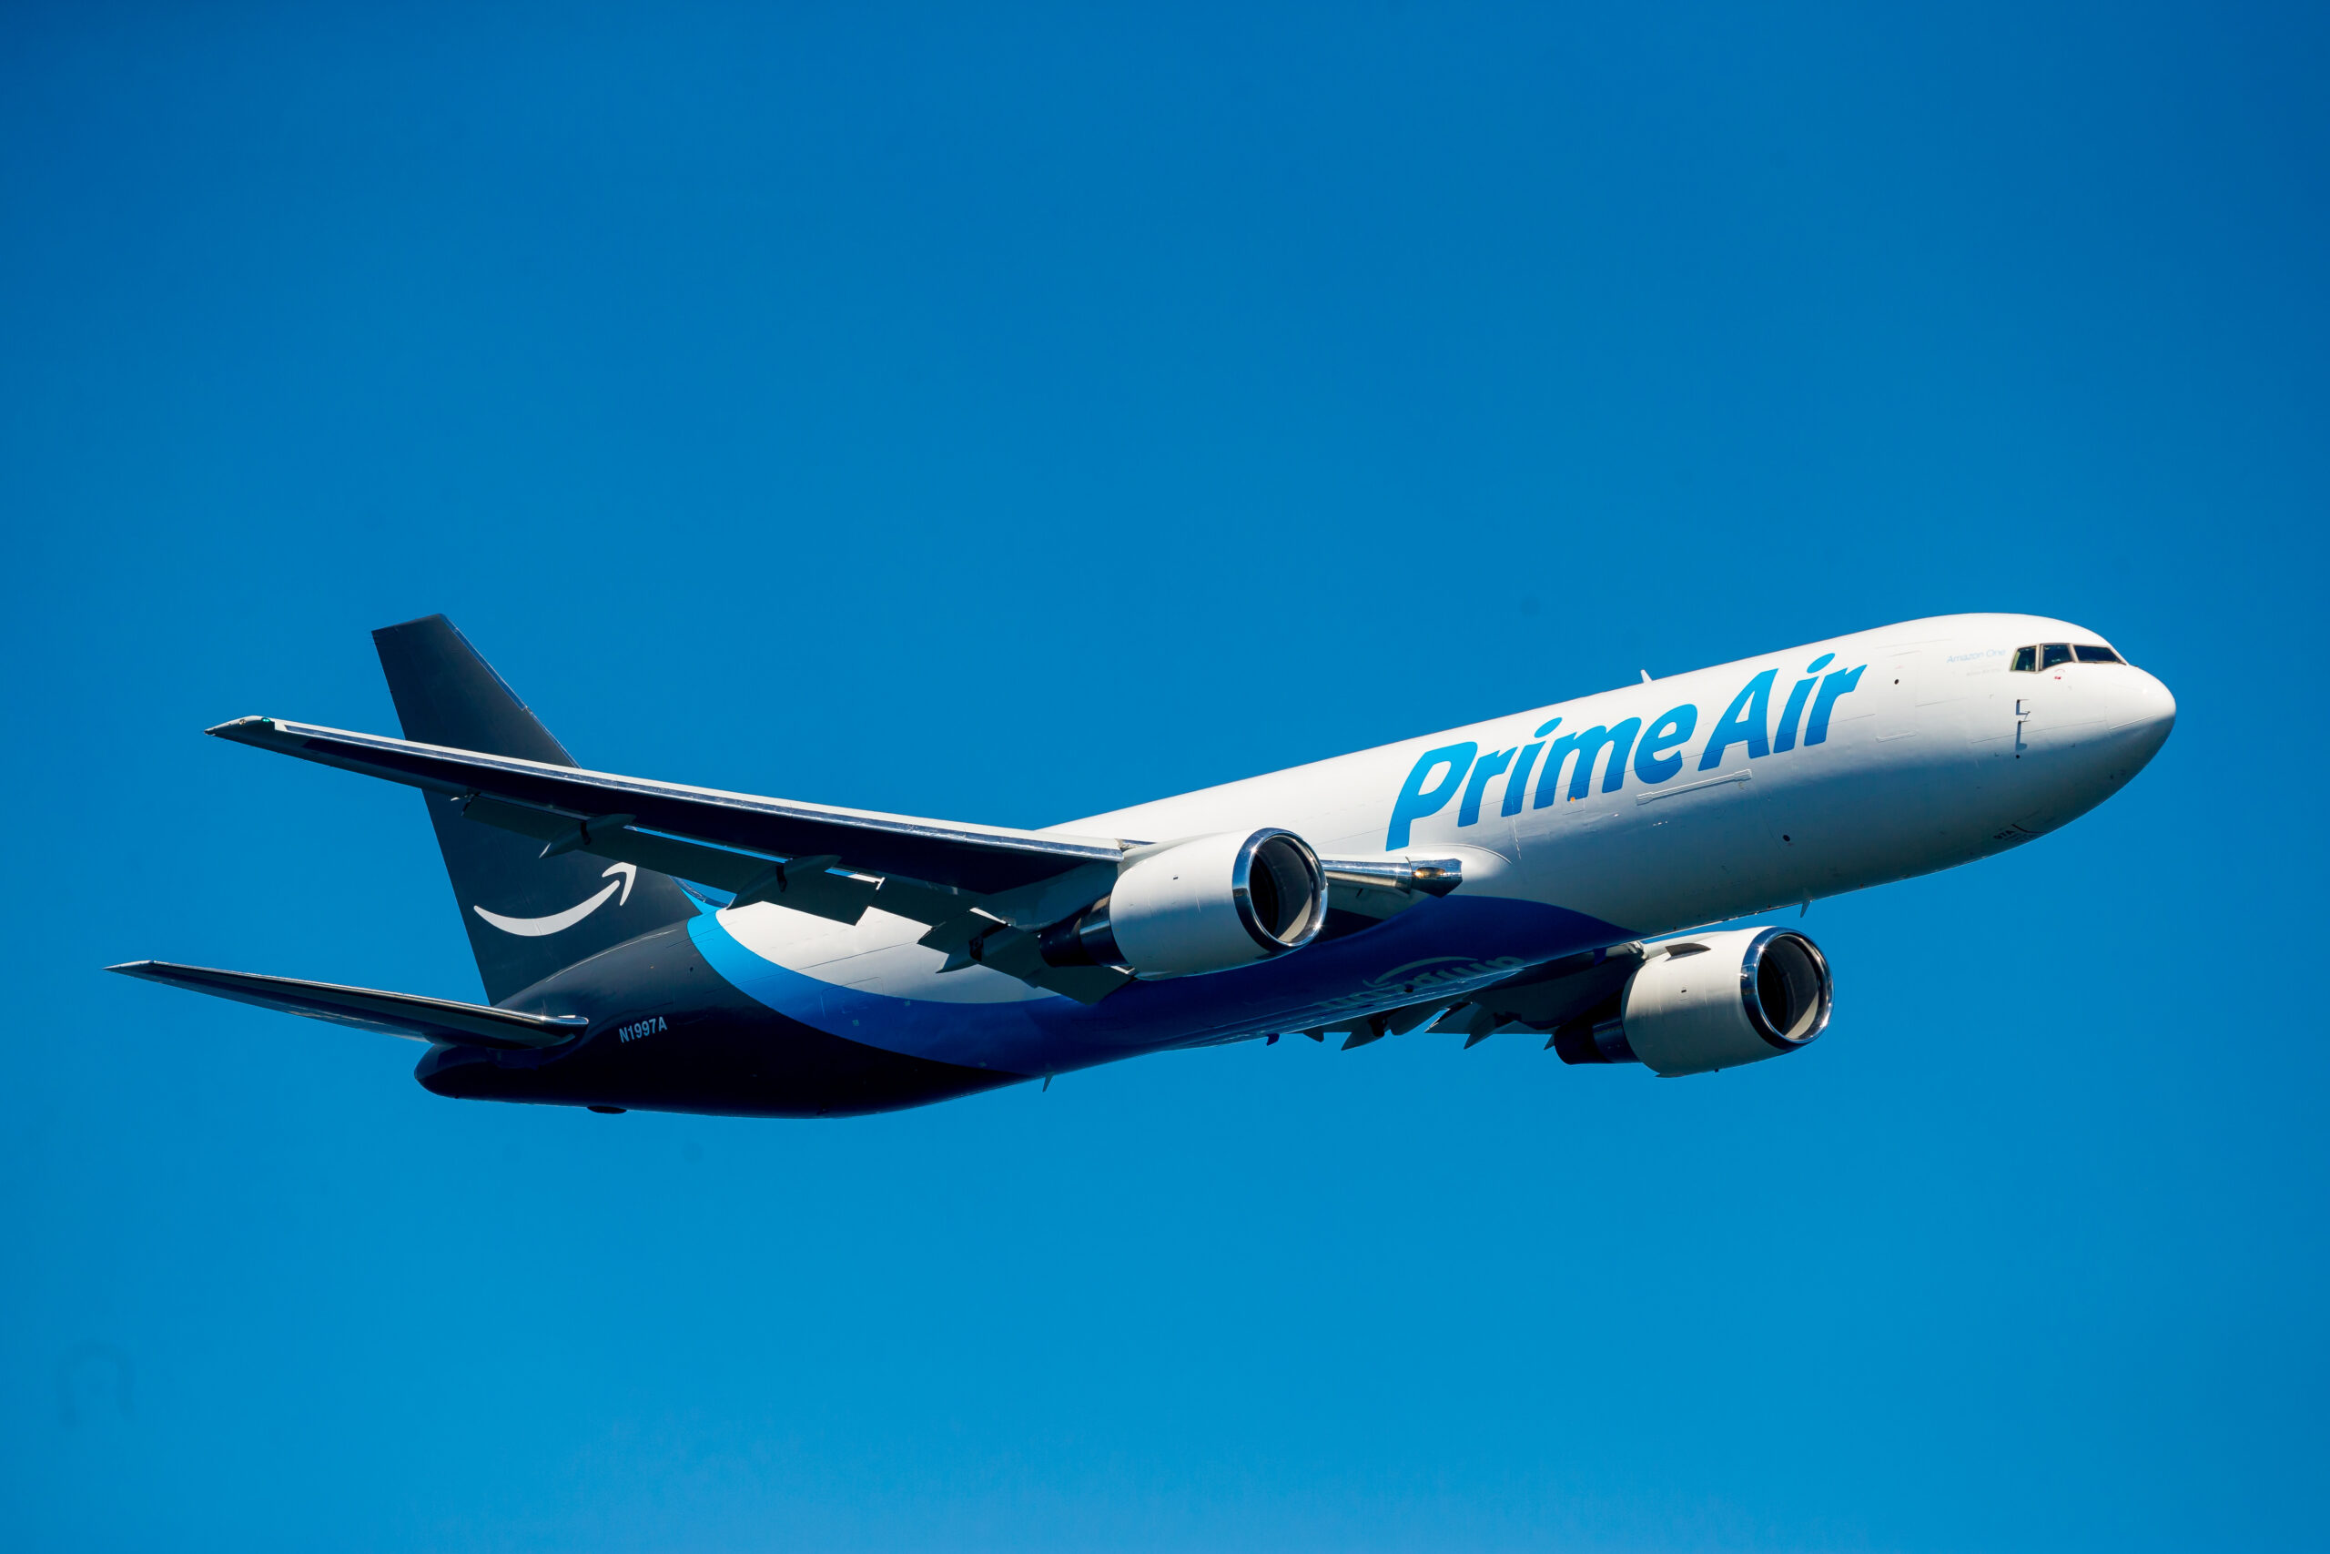

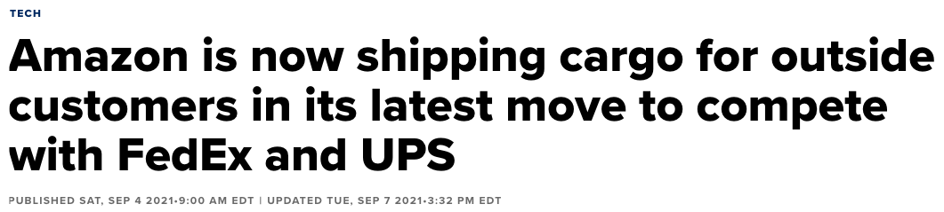

At launch of Fulfillment By Amazon (logistics services for third-party sellers), Jeff Bezos said,
“We have this high IQ part of our business that we spent a lot of time and effort developing. Why shouldn’t we make money off it another way?”
Notes:
Write on the board: Operational capabilities in logistics/supply chain drive strategy of businesses to be in.

Slide 13
Amazon Takeaways
Operational capabilities in logistics/supply chain drive strategy of businesses to be in.
E-Commerce model of centralized inventory (risk pooling) enables economical operations for slow-moving items, but with slow delivery.
Fast delivery of fast-moving items.
Economical to carry close to customers
Slow mover becomes fast mover
Sales
growth
Fast delivery
Pricing power

Slide 14

What’s Next
Tomorrow: Google case report due
Wednesday: Future of Work + Intro to Queue + Littlefield
Friday: Discussion will prepare you for Queue module / HW5 out
Sunday: One-page brief update report for the project
Next week: 2nd meeting with sponsor
Monday: Queue I
Wednesday: Queue II
Friday: Discussion will review Queue concepts + HW4 due
2 weeks from now: Littlefield Simulation (Mon-Thurs)

